Slide 1



Streaming MySQL To ElasticSearch with Kafka

Slide 2
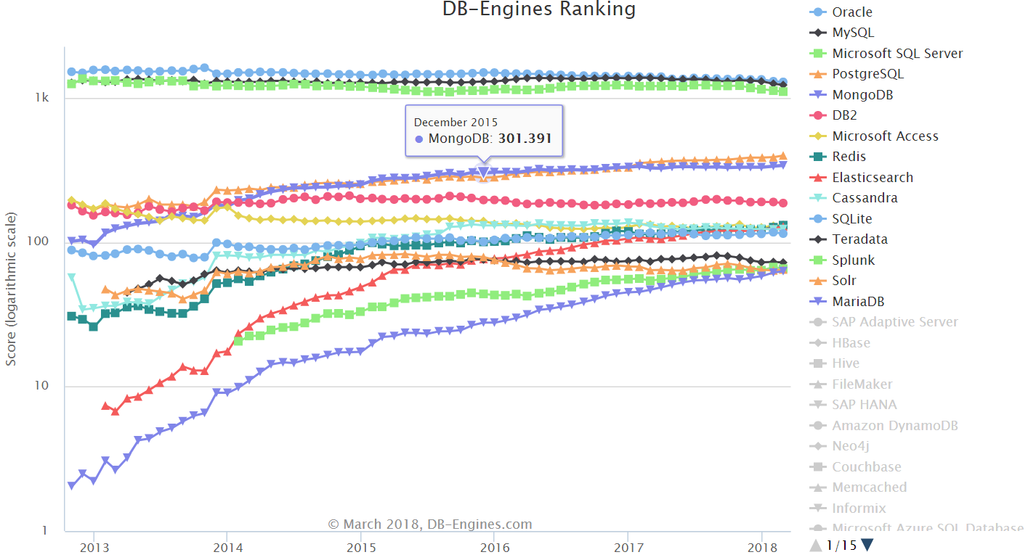
Why MySQL?

Slide 3
Why MySQL
ACID compliance when using InnoDB
Built-in replication support
JSON Data type (Since MySQL 5.7) NoSQL Feature
The world's most popular open source database!
Good community
Stable, Stable and againStable

Slide 4

Why we should avoid to use MySQL FullText Index

Slide 5
Too many Bugs
Bug #83776 - InnoDB FULLTEXT search returns incorrect result for operators on ignored words
Bug #84195 - innodb_ft_result_cache_limit default of 2G seems obscenely high
Bug #75763 - InnoDB FULLTEXT index reduces insert performance by up to 6x on JSON docs
. Another Bug
. Another Bug
. Another Bug

Slide 6
Very Slow
Huge Memory usage
MySQL crashing out of memory
Very slow on million records and Complex Query
So Don’t use Fulltext

